Slide 1
COMPREHENSIVE COURSE MATERIAL & FACILITATOR GUIDE
AI Training Program for
Working Professionals
Prompt Engineering · AI Office Productivity · AI-Assisted Coding · GitHub Copilot
Author
Dinesh Wadhwani
Day 1
Prompt Engineering · AI for Office Productivity
Day 2
AI-Assisted Software Development · GitHub Copilot
Format
4 sessions, approx. 90 minutes each — 6 hours total
Notes:
Welcome everyone. Introduce yourself briefly. Explain that this is a 2-day, 4-session program, and that all material is also provided as a printed book they can keep and refer to later. Mention that English will be kept simple on purpose, and that questions are welcome at any time, in any language.

Slide 2
COURSE OVERVIEW
What We Will Cover Today and Tomorrow
Session 1 — Prompt Engineering
  How to write clear instructions that get useful answers from any AI tool
Session 2 — AI for Office Productivity
  Using AI inside Word, Excel, PowerPoint, email and meetings
Session 3 — AI for Software Development & AI-Assisted Coding
  How AI assists developers across the whole development lifecycle
Session 4 — GitHub Copilot
  A deep dive into the world's most widely used AI coding assistant
WHO THIS IS FOR
Working professionals with some basic AI experience (e.g. ChatGPT). No programming background needed for Sessions 1–2. Sessions 3–4 introduce coding gently, with diagrams, not deep technical detail.
AI Training Program · Dinesh Wadhwani
Notes:
Walk through the four sessions at a high level. Emphasise that each session builds on the previous one, but someone can still follow even if they missed a session. Mention that a full course book has been provided with every example, diagram, and tool list used today.

Slide 3
01
SESSION 1 · DAY 1, 08:45–10:30
Prompt Engineering
How to talk to an AI model so it gives you exactly what you need
BY THE END OF THIS SESSION, YOU WILL BE ABLE TO
Explain how a large language model turns your words into an answer
Build a prompt using the R-C-T-F framework
Apply five core prompting techniques
Rewrite a weak prompt into a strong one
Notes:
This is the foundation session — everything in Sessions 2, 3 and 4 builds on the prompting skills taught here. Take your time on this one.

Slide 4
1.1 WHY IT MATTERS
Two People, Same AI, Different Results
Every AI tool is only as useful as the instruction you give it.
Think of AI as a brilliant new employee on day one: smart, fast, but knows nothing about your company or preferences unless you tell it.
A vague instruction produces a vague result. A clear instruction produces a useful result.
Good news: strong prompting does not need perfect grammar — it needs clear structure. That works in any language.
WEAK VS STRONG
Weak: “Write about our new product.”
Strong: “You are a product marketing writer. Write a 100-word announcement for our new wireless earphones, for 25–35 year olds, upbeat but professional tone, highlighting battery life and price.”
15 extra seconds typing saves 10 minutes of re-writing.
AI Training Program · Dinesh Wadhwani
Notes:
Ask the room: 'think of one task last week that took longer than it should have.' Let 2-3 people answer briefly. Then show the weak vs strong example and ask them to notice the difference is entirely in the instruction, not the AI tool.

Slide 5
1.2 HOW IT WORKS
How a Language Model Actually Works
Trained on an enormous amount of text: books, websites, articles, code.
It learns patterns: given the words so far, what word is likely to come next?
Your prompt becomes 'the words so far' — the model predicts a likely, fluent continuation.
THREE PRACTICAL CONSEQUENCES
1. No memory beyond what you tell it — always give context.
2. It can sound confident while being wrong (a 'hallucination'). Always check facts and numbers.
3. Limited 'context window' — very long documents may need to be split into parts.
AI Training Program · Dinesh Wadhwani
Notes:
Keep this simple and conceptual — no maths needed. The key message: it's predicting likely words, not 'thinking' or 'knowing' the way a person does. This explains both its power (fluent, fast) and its failure mode (confident-sounding mistakes). Stress: always double-check names, numbers, and dates before using AI output for anything important.

Slide 6
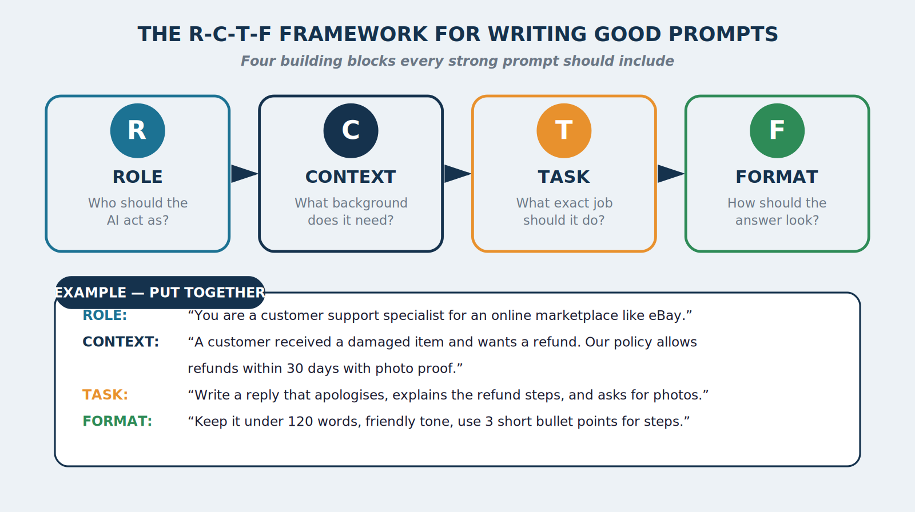
1.3 THE FRAMEWORK
The R-C-T-F Framework
Figure 1.1 — Role, Context, Task, Format: four questions to answer before you write a prompt.
AI Training Program · Dinesh Wadhwani
Notes:
Walk through each letter slowly: Role (who should the AI act as), Context (what background does it need - the most commonly skipped part), Task (what exact job, using an action verb), Format (how should the answer look - length, tone, structure). Then read the worked example at the bottom aloud, pointing at each line as you go.

Slide 7
1.3 THE FRAMEWORK
R-C-T-F in Practice
Role — who should the AI act as?
  Focuses the AI's ‘voice’ and knowledge, e.g. “You are a senior HR manager.”
Context — what background does it need?
  The most frequently skipped, most important ingredient: audience, constraints, source text.
Task — what exact job should it do?
  Use an action verb: summarise, translate, compare, draft, find errors in…
Format — how should the answer look?
  Length, structure, tone, language — removes guesswork from the model.
TIP
You do not always need all four. For a quick, simple question, skip the framework. It earns its value as the task becomes more important or specific — a client email, a report, a policy document.
AI Training Program · Dinesh Wadhwani
Notes:
This slide can be covered quickly since the diagram already introduced the concept — use it to reinforce with the one-line explanation per letter, then move to the tip about not always needing the full framework.

Slide 8
1.4 TECHNIQUES
Five Core Prompting Techniques
1. Zero-shot — ask directly, no examples. Fast, good for common tasks.
2. Few-shot — give 1–2 examples of the style you want before asking.
3. Chain-of-thought — ask the AI to “think step by step.” Reduces careless mistakes.
4. Role (persona) prompting — covered above; one of the highest-impact additions.
5. Iterative refinement — treat prompting as a short conversation, not one command.
FAST REFINEMENT PHRASES
Instead of rewriting the whole prompt, try:
• “Make it shorter”
• “Make it more formal”
• “Add one example”
• “Explain like I am new to this topic”
• “Give me three alternative versions”
AI Training Program · Dinesh Wadhwani
Notes:
Go through each technique briefly. Spend the most time on few-shot (show the customer-reply example from the book, Section 1.4) and chain-of-thought, since these are the two most transformative for daily tasks. Mention that iterative refinement is covered in detail on the next slide with a diagram.

Slide 9
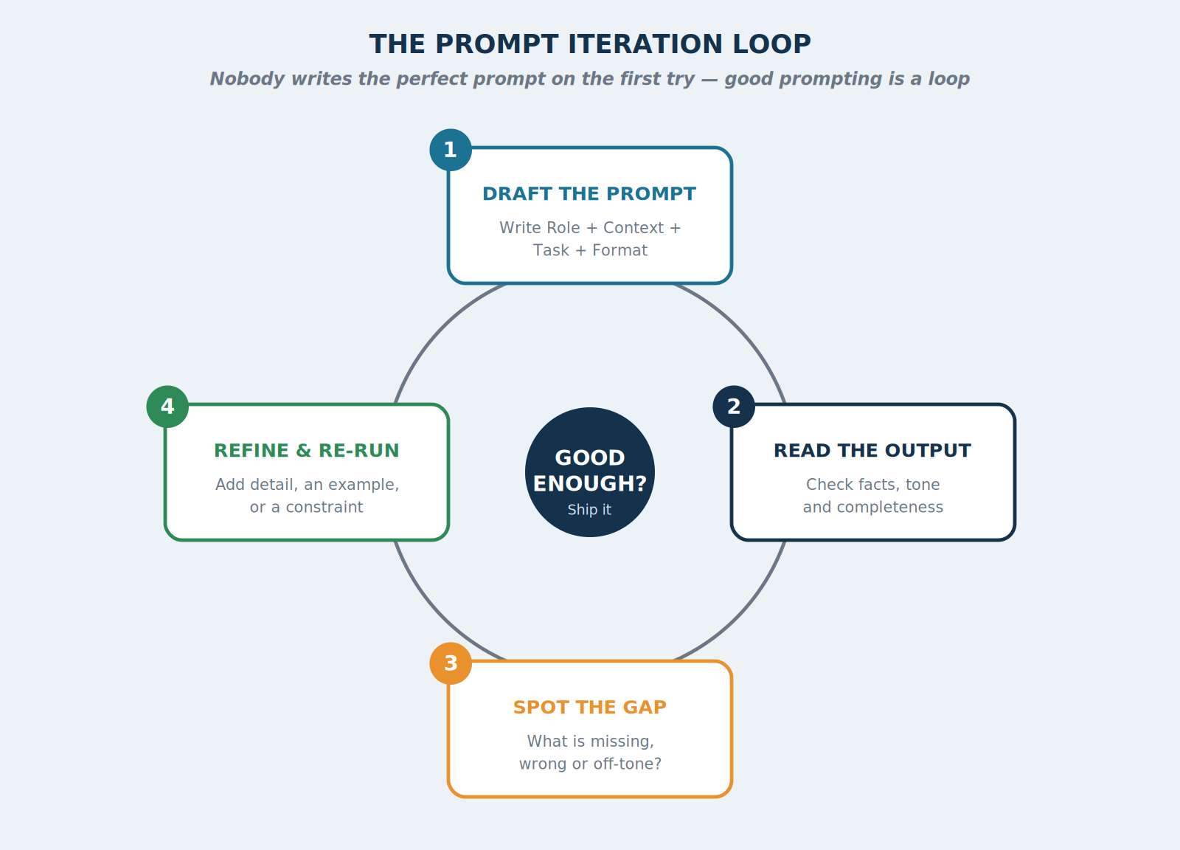
1.4 TECHNIQUES
Prompting Is a Loop, Not a Command
Figure 1.2 — The prompt iteration loop: draft, read, spot the gap, refine, repeat.
AI Training Program · Dinesh Wadhwani
Notes:
Emphasise: nobody writes the perfect prompt on the first try, including experienced users. The loop is normal and expected. Walk around the circle: draft, read the output critically, identify what's missing or wrong, refine with a short follow-up phrase, and repeat until it's good enough to use.

Slide 10
1.5 CASE STUDIES
Real-World Examples — Amazon & eBay
Amazon — Rufus shopping assistant
  Answers customer product questions by combining product data, reviews and general knowledge — context-rich prompting at scale.
Amazon's ‘working backwards’ culture
  Employees draft a structured press-release-style document before building anything — the same discipline as R-C-T-F.
eBay — ‘Magical Listing’ tool
  Writes a listing from a seller's photo. Over 95% of sellers who tried the AI description kept it.
AI Training Program · Dinesh Wadhwani
Notes:
These are real, publicly documented examples — not hypothetical. The eBay statistic (95% of sellers kept the AI-written description) is a strong, concrete number to repeat. Connect this back to Exercise 1 coming up: the same writing task, done with and without a good prompt.

Slide 11
1.5 CASE STUDIES
A Closer Look — Rakuten
Rakuten, a global e-commerce and internet-services group, has invested heavily in generative AI across customer support and product recommendations within its Rakuten Ichiba marketplace.
The same R-C-T-F discipline used to write an eBay listing in English works identically for a marketplace listing in any other language.
Mercari and Rakuten, like eBay, face the same ‘cold start’ listing problem that AI has helped solve.
WHY THIS MATTERS FOR YOU
If your organisation sells or lists products online, the same prompt structure used for a product description works equally well for an internal report, a customer email, or a meeting summary.
AI Training Program · Dinesh Wadhwani
Notes:
Use this slide to add a third global brand to the Amazon/eBay examples. If anyone in the room works in retail, e-commerce, or customer service, this is a good moment to invite a comment or question.

Slide 12
EXERCISE 1
Fix the Weak Prompt
Scenario: Your manager asks you to “use AI to write something for our clients about our new service.” A colleague tries this prompt: “Write something about our new service for clients.”
Your task: Rewrite this into a strong prompt using R-C-T-F. Decide: who is the audience? What is the service? What tone and length?
VERSION A — WITH LAPTOP / INTERNET
VERSION B — PAPER ONLY
With laptop/internet:
Type your improved prompt into any AI chat tool. Run it. Compare the output to what the weak prompt would have likely produced. Share your prompt and result with a neighbour.
Paper only:
Write your improved prompt on paper, labelling each part: R / C / T / F. Exchange with a neighbour. Each person reads the other's prompt aloud and guesses what kind of answer it would produce.
AI Training Program · Dinesh Wadhwani · Facilitator answer key in Appendix C
Notes:
Allow 15 minutes. Circulate the room. If using Version A, help anyone whose AI tool gives an unexpected result — usually it means context was still too thin. Facilitator answer key is in Appendix C of the course book. After the exercise, ask 1-2 volunteers to read their improved prompt aloud.

Slide 13
1.6 TOOL DIRECTORY
Tools for Prompting — Free & Paid
Tool | Type | Best for
ChatGPT | Freemium | General-purpose chat, writing, brainstorming
Claude | Freemium | Long documents, careful writing, coding help
Google Gemini | Freemium | Integrated with Gmail/Docs/Sheets
Microsoft Copilot (Chat) | Freemium | Quick answers in Windows/Edge, M365 integration
Perplexity | Freemium | Research needing up-to-date, cited sources
DeepSeek | Free | Strong reasoning at very low cost
Mistral Le Chat | Freemium | Leading European model, strong multilingual support
Qwen (Alibaba) | Free–Open | Strong open-weight model, good at coding and reasoning
AI Training Program · Dinesh Wadhwani
Notes:
Mention that the full course book (Appendix A) has an even larger directory, including everyday-life tools beyond work. Encourage participants to try at least one free tool from this list this week.

Slide 14
KEY TAKEAWAYS
Key Takeaways — Session 1
An AI model predicts likely words from learned patterns — it has no memory unless you give it context.
R-C-T-F (Role, Context, Task, Format) is a simple, reliable structure for any important prompt.
Five techniques improve results: zero-shot, few-shot, chain-of-thought, role prompting, iterative refinement.
Prompting is a loop — expect to refine two or three times.
Always review AI output for facts, numbers and tone before using it for real work.
AI Training Program · Dinesh Wadhwani
Notes:
Ask one participant to summarise, in their own words, the single most useful idea from this session, before moving to the break and Session 2.

Slide 15
02
SESSION 2 · DAY 1, 10:45–12:15
AI for Office Productivity
Using AI inside the tools you already use every day
BY THE END OF THIS SESSION, YOU WILL BE ABLE TO
Describe how an AI office assistant fits into everyday apps
Use AI to draft, summarise, and polish documents, spreadsheets, slides, and email
Summarise a meeting and draft follow-up actions using AI
Identify free/low-cost office productivity tools to try this month
Notes:
Transition from Session 1: now that participants know how to write a good prompt, this session shows exactly where to use that skill in their daily office work.

Slide 16
2.1 WHY IT MATTERS
The New Office Workday
Microsoft's Work Trend Index research repeatedly finds knowledge workers spend a large share of the day on email, meetings, and searching for information.
AI office assistants attack this directly: drafting a first version, summarising something long, or turning a rough idea into a polished slide — in seconds.
ADOPTION, IN NUMBERS
• ~85% of Nikkei 225 companies (a major global stock index) use Microsoft 365 Copilot in some form
• Sumitomo Corporation: company-wide rollout, roughly $8 million in annual savings
• Dentsu: Copilot automation saves up to 60 minutes per employee, per day
AI Training Program · Dinesh Wadhwani
Notes:
These statistics are the single strongest hook for this session — they are large, public, board-level numbers, not small pilots. Pause on the Sumitomo figure (roughly $8 million annually) and let it land.

Slide 17
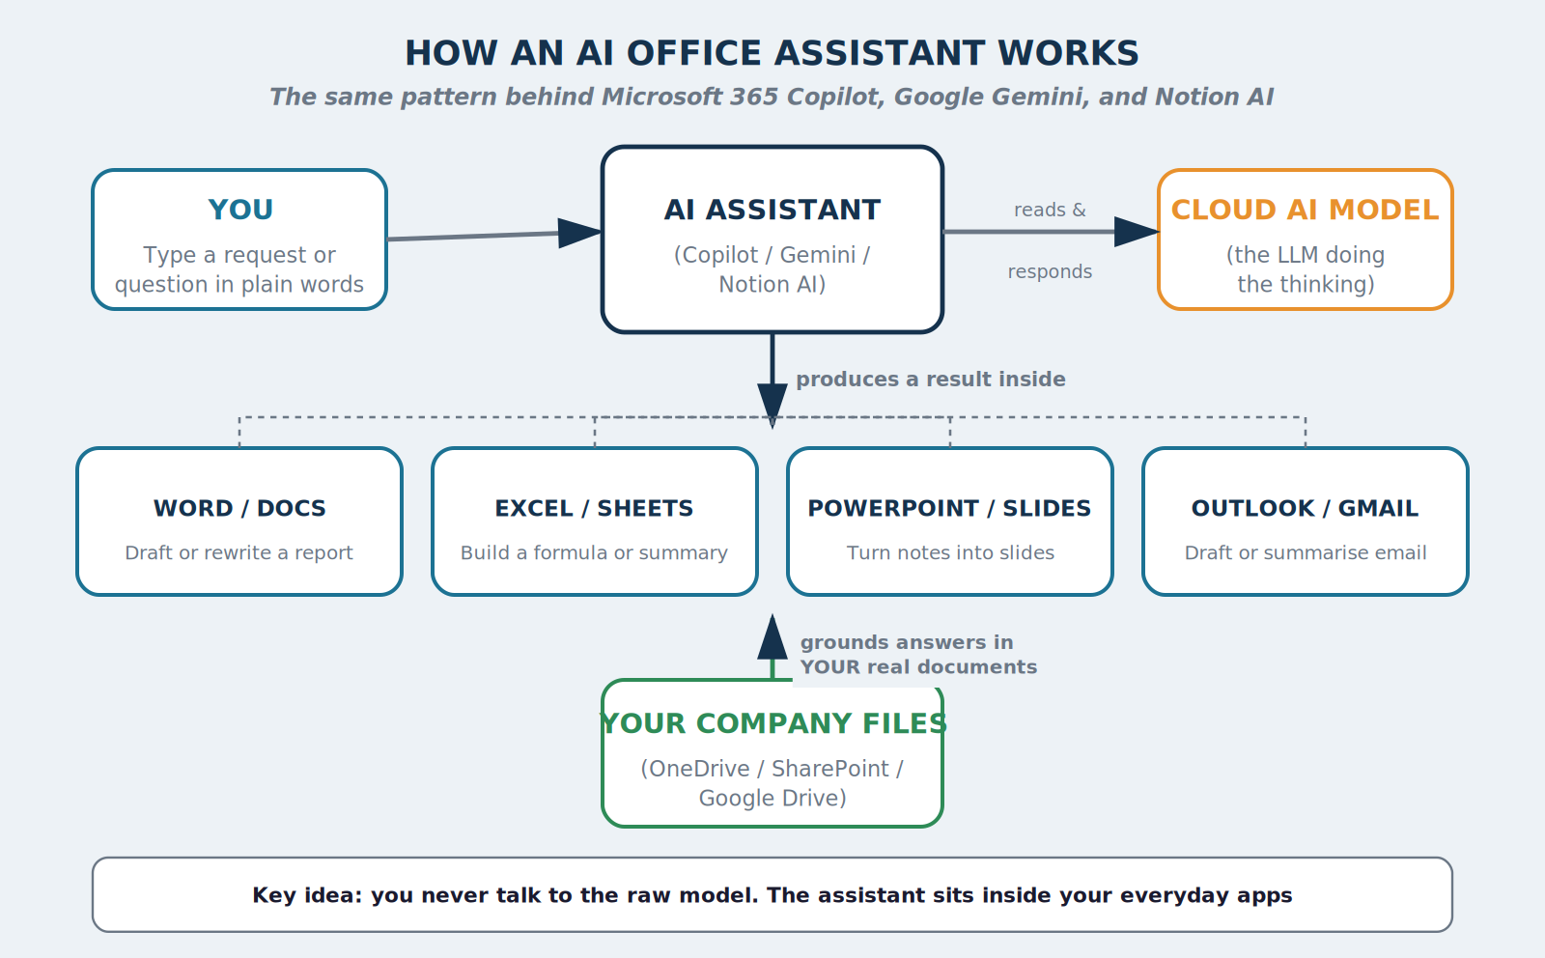
2.2 HOW IT WORKS
How an AI Office Assistant Works
Figure 2.1 — How an AI office assistant connects you, your documents, and the underlying AI model.
AI Training Program · Dinesh Wadhwani
Notes:
Walk through left to right: you type a request, the assistant (Copilot/Gemini/Notion AI) reads it, calls the underlying cloud model, and produces a result inside the app you're already using (Word, Excel, PowerPoint, Outlook). Point out the company files box at the bottom — this is what makes it more useful than a plain chat tool for office work, because it can ground answers in your real documents.

Slide 18
2.2 HOW IT WORKS
Three Things That Make This Powerful
It is grounded in your own files.
  Can answer “summarise last week's sales meeting notes” — not just general knowledge.
It lives inside the app you are already using.
  No copying text to a separate chat window — click the Copilot/AI icon directly in the app.
It respects your organisation's access permissions.
  Will never show you a file you do not already have permission to open.
FACILITATOR TIP
This last point is the most common security question from new users. Repeat it clearly: AI assistants only see what you can already see.
AI Training Program · Dinesh Wadhwani
Notes:
The third point deserves emphasis — it is almost always the first question from a security-conscious audience, and a clear, confident answer here builds trust for the rest of the session.

Slide 19
2.3 IN YOUR APPS
AI Inside Word, Excel & PowerPoint
Word / Google Docs — drafting & rewriting
  “Rewrite this paragraph for a senior executive. Under 80 words. No jargon.”
Excel / Google Sheets — formulas & summaries
  “Write a formula for % growth from the previous month, and explain it in one sentence.”
PowerPoint / Google Slides — notes into slides
  “Turn these 5 bullets into a 6-slide outline: title, agenda, 3 content, summary.”
AI Training Program · Dinesh Wadhwani
Notes:
If laptops are available, consider live-demonstrating one of these three prompts in real time — this is often the single most convincing moment of the whole session.

Slide 20
2.4 EMAIL & MEETINGS
AI for Email and Meetings
Email (Outlook / Gmail)
  Draft replies to long threads; shorten long emails; adjust tone to be more polite for a global audience.
Meetings (Teams / Zoom / Otter.ai)
  Live transcription + automatic summary with decisions and action items, even for absent participants.
MICROSOFT'S OWN EXAMPLE
Internally, Copilot reduced the time to summarise a customer enquiry from 5–10 minutes down to about 5 seconds — cutting workload and human error at the same time.
AI Training Program · Dinesh Wadhwani
Notes:
Mention that most meeting AI tools now support transcription and summarisation in many languages, and some can translate a summary from one language to another — very useful for multilingual meetings with overseas teams.

Slide 21
2.5 CASE STUDIES
Amazon & Sumitomo Corporation
Amazon
  Internal generative AI tools answer large numbers of employee/developer questions automatically, freeing staff for higher-value work.
Sumitomo Corporation
  Rolled out Microsoft 365 Copilot company-wide, after an Early Access Program validation phase. Publicly reported annual savings of roughly $8 million.
AI Training Program · Dinesh Wadhwani
Notes:
Sumitomo is a particularly strong example because it is a large, traditional trading and investment group — not a technology start-up — showing that this is not only for ‘tech companies.’

Slide 22
2.5 CASE STUDIES
JCB — Meeting People Where They Work
JCB chose Microsoft 365 Copilot specifically because employees already used Word, Excel and PowerPoint daily.
The AI icon simply appeared inside tools people already trusted — no need to learn a brand-new system.
JCB built an internal ‘Generative AI Utilization Hub’ to share good prompts between teams.
AN IDEA TO COPY
Any organisation in this room could start its own internal prompt-sharing channel or document, exactly like JCB's Hub — it costs nothing and accelerates adoption.
AI Training Program · Dinesh Wadhwani
Notes:
Invite the room to consider: does your organisation already have a channel for sharing good prompts? If not, suggest starting one this week.

Slide 23
EXERCISE 2
Turn Notes Into a Polished Output
Scenario: Rough meeting notes: “Discussed Q2 launch. Marketing wants more budget. Engineering says timeline is tight, maybe slip 2 weeks. Sales is confident about demand in the North and South regions. Need decision from Director by Friday. Action: Priya to prepare budget options, Sam to check engineering timeline.”
Your task: Using R-C-T-F, turn these notes into (a) a 3-line executive summary and (b) a clear action-item table with owner and deadline.
VERSION A — WITH LAPTOP / INTERNET
VERSION B — PAPER ONLY
With laptop/internet:
Write your prompt, run it in any AI tool, and compare results with a neighbour.
Paper only:
By hand, write the 3-line summary and action table. Then write the prompt you would have used, labelling R / C / T / F.
AI Training Program · Dinesh Wadhwani · Facilitator answer key in Appendix C
Notes:
Allow 20 minutes. This is a very realistic, high-value office task — most participants will recognise this exact situation from their own meetings. Model answer is in Appendix C.

Slide 24
2.6 TOOL DIRECTORY
Tools for Office Productivity — Free & Paid
Tool | Type | Best for
Microsoft 365 Copilot | Paid add-on | Word, Excel, PowerPoint, Outlook, Teams
Google Gemini for Workspace | Paid add-on | Docs, Sheets, Slides, Gmail, Meet
Notion AI | Freemium | Notes, wikis, project docs
Grammarly | Freemium | Grammar, tone and clarity for English writing
Otter.ai / Zoom AI Companion | Freemium | Meeting transcription and summaries
Canva (Magic Write/Design) | Freemium | Quick slides and graphics from a prompt
DeepL | Freemium | High-quality translation across many language pairs
Slack AI / Rakuten AI for Business | Paid | Business messaging and retail/e-commerce AI tools
AI Training Program · Dinesh Wadhwani
Notes:
Encourage participants to pick just one tool from this list to try in the next week — not all of them at once.

Slide 25
KEY TAKEAWAYS
Key Takeaways — Session 2
AI office assistants sit inside the tools you already use — Word, Excel, PowerPoint, Outlook, Teams.
They are grounded in your own permitted files, making them safer and more useful than a general chat tool.
Real deployments (Sumitomo, JCB, Dentsu) show large-scale, measurable savings.
Highest-value starting points: drafting/rewriting documents, Excel formulas, notes-to-slides, meeting summaries.
Always review AI-drafted content for tone, accuracy and policy before sending it externally.
AI Training Program · Dinesh Wadhwani
Notes:
This closes Day 1. Remind participants that Day 2 shifts to a more technical topic — AI for software development — but reassure non-engineers that it remains accessible, with no coding required to follow along.

Slide 26
03
SESSION 3 · DAY 2, 08:45–10:30
AI for Software Development
& AI-Assisted Coding
How AI changes the way software gets built, tested and shipped
BY THE END OF THIS SESSION, YOU WILL BE ABLE TO
Identify where AI assists each stage of the development lifecycle
Explain the daily workflow of a developer using an AI pair-programming tool
Describe real productivity results from Amazon, eBay and Mercari
Recognise the main categories of AI coding tools, free and paid
Notes:
Welcome back for Day 2. Reassure non-engineers in the room: you do not need to know how to code to follow this session — the goal is to understand the big picture well enough to manage, evaluate, or discuss AI coding tools with a technical team.

Slide 27
3.1 WHY IT'S CHANGING
Why Coding Is Changing
Writing software has traditionally been slow: a large share of time goes to repetitive, well-understood tasks — boilerplate code, tests, documentation search, small bug fixes.
AI coding assistants directly target these repetitive tasks.
ADOPTION IN NUMBERS
• 82% of developers using AI tools use ChatGPT
• 68% use GitHub Copilot
(2025 Stack Overflow Developer Survey)
• GitHub Copilot: 26M+ users worldwide, across virtually every country with an active software industry
AI Training Program · Dinesh Wadhwani
Notes:
These numbers show that AI-assisted coding has moved from experimental to mainstream in only a few years. Mention that Session 4 will go much deeper into GitHub Copilot specifically.

Slide 28
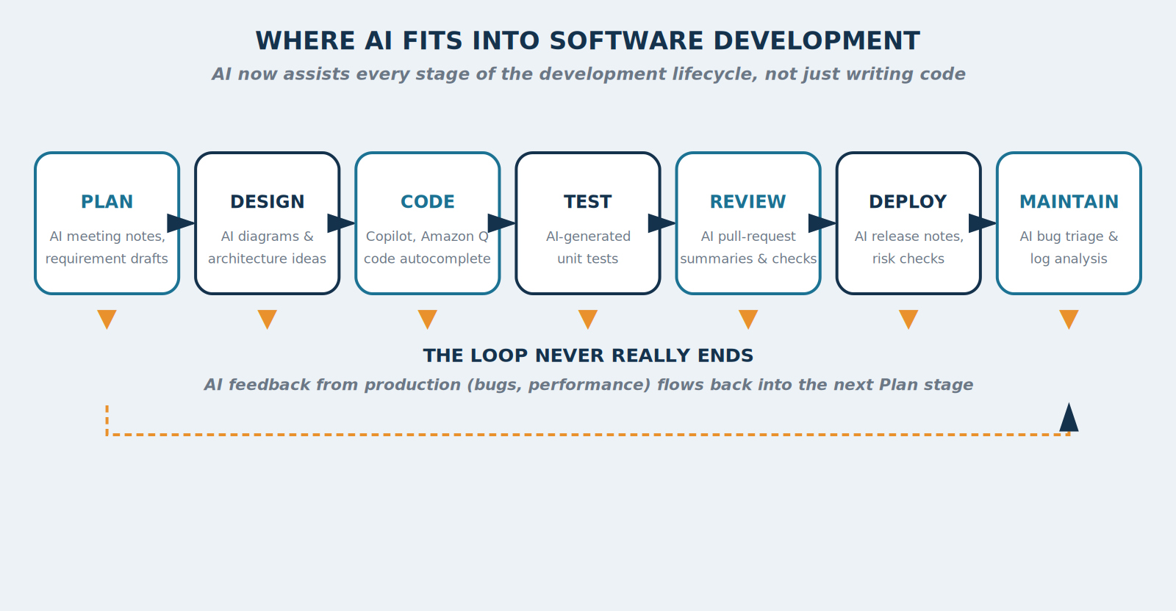
3.2 ACROSS THE LIFECYCLE
AI Across the Development Lifecycle
Figure 3.1 — Where AI fits into each stage of the software development lifecycle.
AI Training Program · Dinesh Wadhwani
Notes:
Correct a common misconception here: AI coding is not just autocomplete while typing. Walk left to right across all 7 stages, then point out the dashed feedback loop at the bottom — production feedback (bugs, performance) flows back into planning the next cycle.

Slide 29
3.2 ACROSS THE LIFECYCLE
Plan, Design, Code, Test
Plan & Design
  AI drafts requirement documents from meeting notes; suggests a first-pass architecture from a plain description.
Code
  The best-known use: AI suggests the next lines, or a whole function, as a developer types.
Test
  AI generates unit tests automatically — traditionally one of the most skipped parts of development.
AMAZON Q DEVELOPER
Helped migrate ~30,000 internal applications from an old Java version to a modern one, saving an estimated 4,500 developer-years and $260 million per year. Developers were 27% more likely to complete a task successfully.
AI Training Program · Dinesh Wadhwani
Notes:
The Amazon Q Developer statistic is one of the most impressive in the entire course — 4,500 developer-years saved is a genuinely enormous number. Give the room a moment to absorb it.

Slide 30
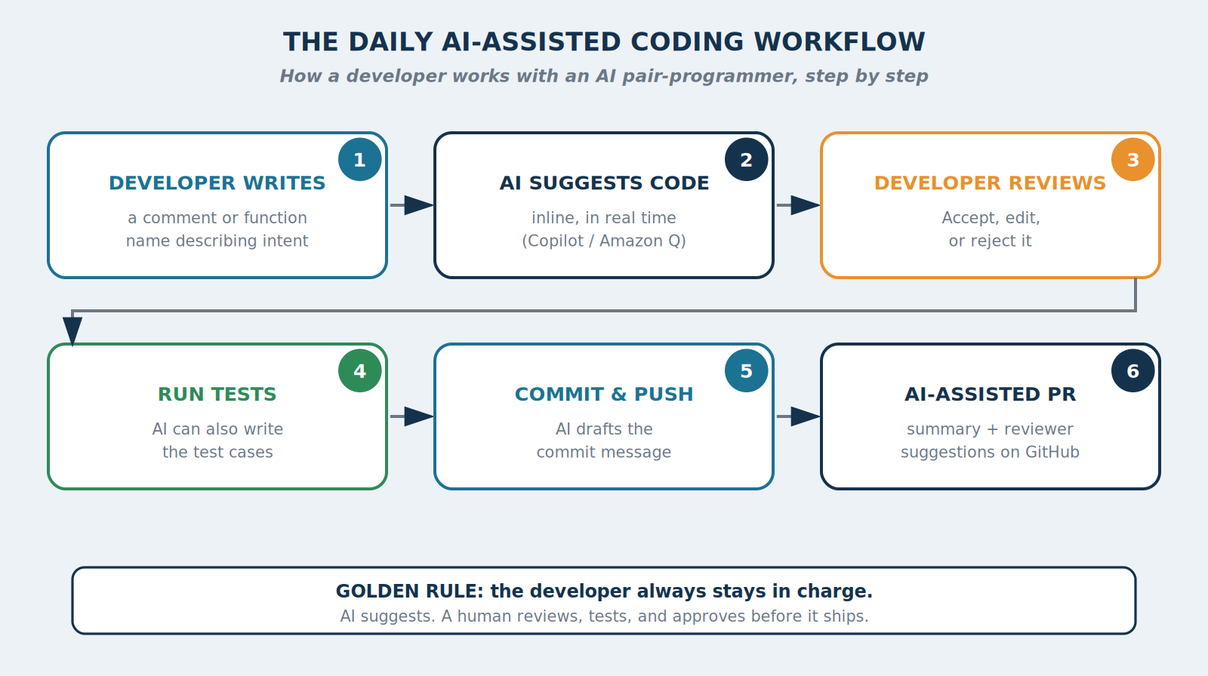
3.3 DAILY WORKFLOW
The Daily AI-Assisted Coding Workflow
Figure 3.2 — From developer intent to a reviewed pull request, with a human in charge at every step.
AI Training Program · Dinesh Wadhwani
Notes:
Walk through all 6 steps. The most important message on this slide: a human reviews the output at every single stage. AI assists, it does not replace, the developer's judgement. This is worth repeating clearly and slowly.

Slide 31
3.3 DAILY WORKFLOW
Describing a Task Clearly Enough for AI
The same R-C-T-F thinking from Session 1 applies directly to coding — often as a single comment.
Common everyday uses: autocomplete, ‘explain this code’, ‘find the bug’, ‘write the tests’, translating code between languages.
EXAMPLE: A ONE-LINE PROMPT
// Function to validate a postal code (format: 12345 or 12345-6789) and return true/false
The AI reads this comment as Context + Task, and suggests a working function immediately below it.
AI Training Program · Dinesh Wadhwani
Notes:
Point out that you do not need to be a programmer to understand this example — it is simply a clear, specific instruction, exactly like the R-C-T-F prompts from Session 1.

Slide 32
3.4 CASE STUDIES
Amazon & eBay — Engineering at Scale
Amazon Q Developer
  One of the largest publicly disclosed AI-coding success stories in the industry (see Section 3.2 figures).
eBay engineering
  Beyond the customer-facing ‘Magical Listing’ tool, eBay's own engineering organisation has long been an adopter of AI developer tools as part of its broader AI strategy.
AI Training Program · Dinesh Wadhwani
Notes:
Reinforce the pattern: the same company that uses AI to help its customers (eBay's Magical Listing from Session 1) also uses AI to help its own engineers move faster.

Slide 33
3.4 CASE STUDIES
Mercari — a Global Marketplace, AI-Native
Mercari — a major consumer-to-consumer marketplace, often compared to eBay — has rolled out both GitHub Copilot and Cursor to its entire engineering organisation of roughly 2,000 people.
Both tools are available for every engineer to use, not restricted to a pilot group.
Mercari's engineering leadership speaks publicly about building an ‘AI-native’ engineering culture — understanding what AI can and cannot do, as a change in working habits, not just a new tool.
WHY MERCARI IS A USEFUL REFERENCE
Mercari faces the same scale challenges as eBay: millions of listings, fraud detection, and search relevance, all at national scale.
AI Training Program · Dinesh Wadhwani
Notes:
Mercari is likely one of the most relatable examples in this session — many participants may recognise the app. Pause here for questions.

Slide 34
EXERCISE 3
Write the Comment, Predict the Code
Scenario: You do not need to know how to code — you are practising describing a task clearly, as you would to a junior colleague or an AI tool.
Your task: Write a one-sentence instruction (as a code comment) for ONE of: (1) validate a phone number format, (2) calculate order total with 8% shipping + 10% tax, (3) sort customer names alphabetically, ignoring case.
VERSION A — WITH LAPTOP / INTERNET
VERSION B — PAPER ONLY
With laptop/internet:
Type your instruction into any AI tool (“Write a function that…”). Read the explanation — does it match what you asked for?
Paper only:
Swap instructions with a neighbour. Each writes the step-by-step logic they'd expect, in plain English. Compare understanding.
AI Training Program · Dinesh Wadhwani · Facilitator answer key in Appendix C
Notes:
Allow 20 minutes, pairs recommended. The goal is not correct code — it's clarity of instruction. Model answer is in Appendix C.

Slide 35
3.5 TOOL DIRECTORY
Tools for AI-Assisted Coding — Free & Paid
Tool | Type | Best for
GitHub Copilot | Freemium | In-editor autocomplete + chat (full detail in Session 4)
Amazon Q Developer | Freemium | AWS projects; strong at code migration
Cursor | Freemium | AI-first code editor; whole-codebase understanding
Claude Code | Paid | Autonomous agent for larger, multi-step tasks
Codeium / Windsurf | Freemium | Free-friendly autocomplete and chat
Tabnine | Freemium | Privacy-focused, can run on private infrastructure
Replit AI | Freemium | Learn to code; build/deploy small apps in-browser
JetBrains AI | Freemium | Built into IntelliJ, PyCharm and other JetBrains IDEs
AI Training Program · Dinesh Wadhwani
Notes:
Note that GitHub Copilot gets its own full session next — this table is a broader map of the category.

Slide 36
KEY TAKEAWAYS
Key Takeaways — Session 3
AI now assists nearly every stage of development — planning, testing, review, deployment, maintenance.
The daily workflow keeps a human in charge at every step: intent, suggestion, review, test, commit.
Amazon saved thousands of developer-years and hundreds of millions of dollars using its own AI coding agent.
Mercari, a major consumer-to-consumer marketplace, has deployed GitHub Copilot and Cursor to ~2,000 engineers.
You do not need to code to describe a task clearly — the same structured-instruction skill from Session 1 applies.
AI Training Program · Dinesh Wadhwani
Notes:
Bridge to Session 4: 'Now that we understand the big picture of AI-assisted coding, let's go deep on the single most widely used tool in this space — GitHub Copilot.'

Slide 37
04
SESSION 4 · DAY 2, 10:45–12:15
GitHub Copilot
A deep dive into the world's most widely used AI coding assistant
BY THE END OF THIS SESSION, YOU WILL BE ABLE TO
Explain what GitHub Copilot is and how it works, end to end
Describe the Copilot product family
Set up Copilot step by step in a code editor
Compare plans and choose the right one
Describe real adoption results from NTT Docomo, Fujitsu and Sony
Notes:
This is the final session of the program. Keep energy high — this is the most concrete, practical session, ending with a hands-on rollout-planning exercise.

Slide 38
4.1 WHAT IT IS
What GitHub Copilot Is
Launched by GitHub (owned by Microsoft) and OpenAI in 2021 — the first mainstream AI coding assistant, still the most widely used today.
More than 26 million users worldwide.
Works as an extension inside your code editor: suggests code as you type, and answers questions in a chat panel.
Unlike a general chat tool, it reads your open files and project structure automatically — no need to paste code into a separate window.
AI Training Program · Dinesh Wadhwani
Notes:
Set the scene: this tool is the industry standard reference point, which is why it gets an entire dedicated session.

Slide 39
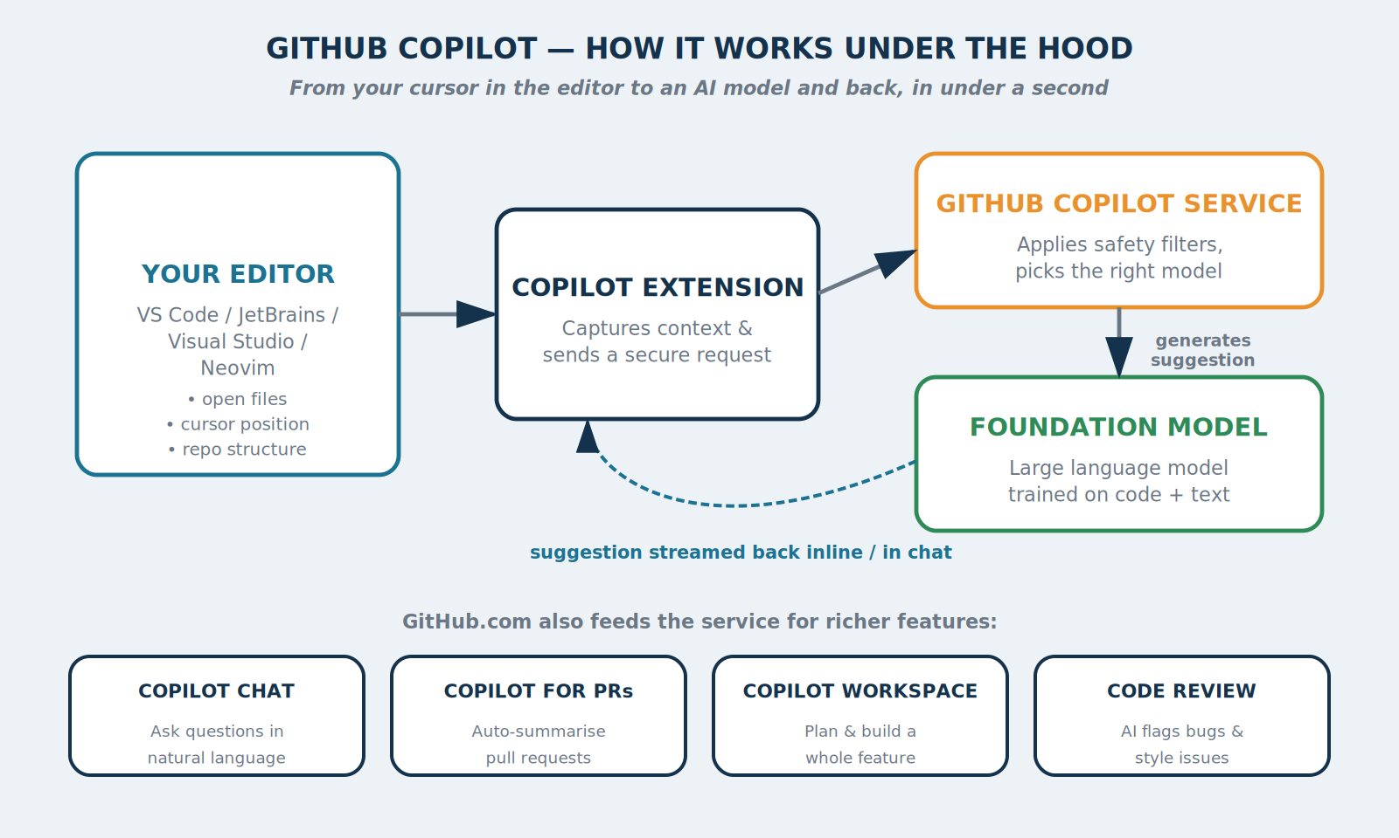
4.2 UNDER THE HOOD
How Copilot Works Under the Hood
Figure 4.1 — GitHub Copilot's architecture, from your editor to the foundation model and back.
AI Training Program · Dinesh Wadhwani
Notes:
Walk through the 4 steps: editor captures context, extension sends a secure request, service applies safety filters and routes to a model, model generates a suggestion that streams back in under a second. Then point at the 4 feature boxes at the bottom (Chat, PRs, Workspace, Code Review) as a preview of the next slide.

Slide 40
4.2 – 4.3
A Compliance Answer & the Product Family
Copilot Chat
  Conversational panel for asking questions or explaining code in natural language.
Copilot for Pull Requests
  Auto-generates a plain-language summary of what changed and why.
Copilot Workspace
  Plans and implements a whole small feature across multiple files, with developer approval.
Copilot Code Review
  AI reviewer flags likely bugs or style issues before a human looks at the change.
A COMMON COMPLIANCE QUESTION
For Business and Enterprise plans, GitHub contractually commits that your organisation's code is NOT used to train Copilot's models. Often the single most important sentence for a security/legal team.
AI Training Program · Dinesh Wadhwani
Notes:
The compliance callout is extremely important — flag it clearly as 'the sentence to remember if you take only one fact from this slide.'

Slide 41
4.4 GETTING STARTED
Getting Started, Step by Step
1. Create or sign in to a GitHub account at github.com (free).
2. Choose a plan — start with Free, no credit card required.
3. Install your editor's Copilot extension (VS Code, JetBrains, Visual Studio, Neovim).
4. Sign in to Copilot from inside the editor (secure browser link).
5. Start typing — suggestions appear as grey ‘ghost text.’ Press Tab to accept.
6. Open Copilot Chat to ask questions in plain, natural language.
7. Try slash commands: /explain, /fix, /tests, /doc
YOUR FIRST 5 MINUTES
Open any file and type into Copilot Chat: “Explain what this file does, in simple terms, for someone new to the project.” One of the fastest ways to get comfortable in an unfamiliar codebase.
AI Training Program · Dinesh Wadhwani
Notes:
If laptops are available, this is the ideal moment for a live, guided walkthrough — have everyone (or a volunteer) follow these 7 steps together in real time.

Slide 42
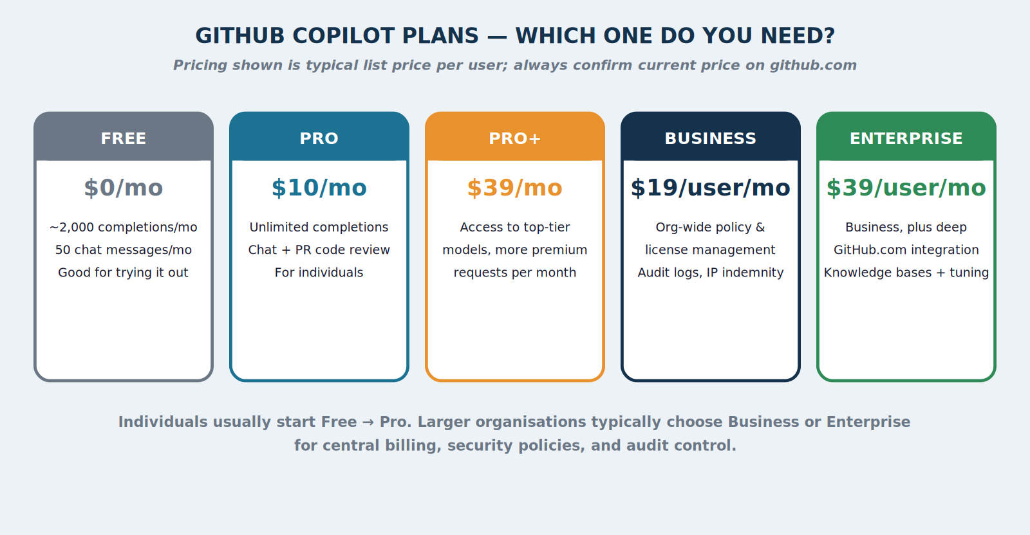
4.5 PLANS & PRICING
Which Plan Do You Need?
Figure 4.2 — GitHub Copilot's plans, Free to Enterprise. Confirm current prices at github.com before budgeting.
AI Training Program · Dinesh Wadhwani
Notes:
Individuals typically start Free then move to Pro ($10/month). Organisations almost always choose Business ($19/user/month) or Enterprise ($39/user/month) for centralised billing, policy control, audit logs, and the data-protection guarantee from the previous slide.

Slide 43
4.6 CASE STUDIES
NTT Docomo — Measurable Daily Usage
Using GitHub Copilot since March 2023.
3,647 developers use it, with roughly 1,000 actively using it on an average day.
More than 30,000 code suggestions received per day.
About 25% of suggestions are accepted into real production work.
WHY THIS NUMBER MATTERS
A 25% acceptance rate, tracked transparently, is a concrete adoption metric any engineering manager in this room can relate to and replicate when measuring their own rollout.
AI Training Program · Dinesh Wadhwani
Notes:
This is one of the strongest adoption statistics in the whole course — it is precise, transparent, and recently reported (a November 2025 GitHub Japan briefing). Repeat the 25% figure clearly.

Slide 44
4.6 CASE STUDIES
Fujitsu, Sony & ZOZO
Fujitsu
  Piloted Copilot + Microsoft Dev Box with 2,400 developers. Result: 20% workload reduction, while meeting strict security requirements.
Sony and ZOZO
  Publicly named by GitHub among confirmed enterprise adopters — spanning electronics and retail, not just ‘pure’ technology companies.
A PATTERN WORTH NOTICING
Every case study in this course shares one feature: adoption was measured carefully, not adopted on faith. Good practice for any organisation piloting Copilot.
AI Training Program · Dinesh Wadhwani
Notes:
Close the case-studies section by drawing this pattern together explicitly: measurement discipline is the common thread across Docomo, Fujitsu, Sony and ZOZO.

Slide 45
EXERCISE 4
Plan a Copilot Rollout
Scenario: Your organisation is considering GitHub Copilot for a 50-person engineering team.
Your task: As a group, decide: (1) which plan fits best and why, (2) one metric to track in month one, (3) one security question to ask before rollout.
VERSION A — WITH LAPTOP / INTERNET
VERSION B — PAPER ONLY
With laptop/internet:
Visit github.com/features/copilot and answer all three questions as a group, using the live pricing page.
Paper only:
Answer the same three questions using the pricing figure and case studies from this session. Present your plan to the room in two minutes.
AI Training Program · Dinesh Wadhwani · Facilitator answer key in Appendix C
Notes:
Allow 15 minutes for group work, then 5 minutes for 1-2 groups to present. Model answer is in Appendix C: Business plan for 50 people, track weekly active users + acceptance rate (NTT Docomo's approach), ask about the no-training-on-your-code guarantee.

Slide 46
KEY TAKEAWAYS
Key Takeaways — Session 4
Copilot connects your editor, a context-aware service, and a foundation model — suggestions return in under a second.
It's a family of tools: Completions, Chat, Pull Requests, Workspace, Code Review.
Getting started takes about five minutes: install, sign in, start typing.
Business/Enterprise plans guarantee your code is not used to train Copilot's models.
Real-world deployments (NTT Docomo, Fujitsu, Sony, ZOZO) show measurable, significant results.
AI Training Program · Dinesh Wadhwani
Notes:
This closes the technical content of the course. Move to the final wrap-up slide next.

Slide 47
THANK YOU
Questions & Discussion
Prompt Engineering · AI Office Productivity · AI-Assisted Coding · GitHub Copilot
A full course book, with every example, diagram and tool list, has been provided for your continued reference.
Notes:
Thank the room. Open the floor for final questions across all four sessions. Remind them the course book (PDF) contains every example, diagram, exercise answer key, and the larger master tool directory in Appendix A, for their continued reference after today.

